Slide 1





DIGITAL PORTFOLIO
DIGITAL PORTFOLIO
STUDENT NAME: ARSHIYA D
REGISTER NO AND NMID: 34624U18003 & astvu346m24607 DEPARTMENT:B.SC.COMPUTER SCIENCE COLLEGE/UNIVERSITY: M.M.E.S. WOMEN’S ARTS AND SCIENCES COLLEGE & THIRUVALLUR UNIVERSITY
STUDENT NAME: AYSHA SIDDIQUA.K
REGISTER NO AND NMID: 34624U18007 & astvu346m24614 DEPARTMENT:B.SC.COMPUTER SCIENCE COLLEGE/UNIVERSITY: M.M.E.S. WOMEN’S ARTS AND SCIENCES COLLEGE & THIRUVALLUR UNIVERSITY

Slide 2

PROBLEM STATEMENT PROJECT OVERVIEW END USERS TOOLS AND TECHNOLOGIES PORTFOLIO DESIGN AND LAYOUT FEATURES AND FUNCTIONALITY RESULTS AND SCREENSHOT CONCLUSION GITHUBLINK
PROBLEM STATEMENT PROJECT OVERVIEW END USERS TOOLS AND TECHNOLOGIES PORTFOLIO DESIGN AND LAYOUT FEATURES AND FUNCTIONALITY RESULTS AND SCREENSHOT CONCLUSION GITHUBLINK

Slide 3
PROBLEM STATEMENT
PROBLEM STATEMENT
In today’s digital era, traditional resumes alone are not enough to showcase skills and project effectively. Many students and professionals lack a structured online presence to highlight their work. A digital portfolio provides an interactive and accessible platform to present achievement, skills and experience.
In today’s digital era, traditional resumes alone are not enough to showcase skills and project effectively. Many students and professionals lack a structured online presence to highlight their work.Adigital portfolio provides an interactive and accessible platform to present achievement, skills and experience.

Slide 4

PROJECT OVERVIEW
PROJECT OVERVIEW
• • •
Brief summary of my project What my portfolio contains (about me, projects, skills, contact). Main idea: showcase personal achievement, skills, and projects.
Brief summary of my project What my portfolio contains (about me, projects, skills, contact). Main idea: showcase personal achievement, skills, and projects.

Slide 5
WHO ARE THE END USERS?
WHO ARE THE END USERS?
• • • •
Students (academic projects, resumes). Job seekers (to share with recruiters).
Students (academic projects, resumes). Job seekers (to share with recruiters).
Freelancers (to show clients). Professionals(to highlight experience and achievement).
Freelancers (to show clients). Professionals(to highlight experience and achievement).

Slide 6
TOOLS AND TECHNIQUES
TOOLS AND TECHNIQUES
• • • •
Html: structure (pages, sections). CSS: styling (colours, layouts, responsiveness). JavaScript: interactively(navigation menu, animation, from validation). Mention code editor (VS code)or CODEPEN and hosting platform (GitHub pages).
Html: structure (pages, sections). CSS: styling (colours, layouts, responsiveness). JavaScript: interactively(navigation menu, animation, from validation). Mention code editor (VS code)or CODEPEN and hosting platform (GitHub pages).

Slide 7
PORTFOLIO DESIGN AND LAYOUT
PORTFOLIO DESIGN AND LAYOUT
• • • • • •
Sections included: Home/ about me
Sections included: Home/ about me
Projects Skills
Projects Skills
Contact Responsive layout (mobile+desktopview).
Contact Responsive layout (mobile+desktopview).

Slide 8
FEATURES AND FUNCTIONALITY
FEATURES AND FUNCTIONALITY
• • • • •
Navigation bar with smooth scrolling. Project showcase with images/details. Interactive elements (hover effects, animation). Contact form (with validation).
Navigation bar with smooth scrolling. Project showcase with images/details. Interactive elements (hover effects, animation). Contact form (with validation).
Responsive design for all devices.
Responsive design for all devices.

Slide 9
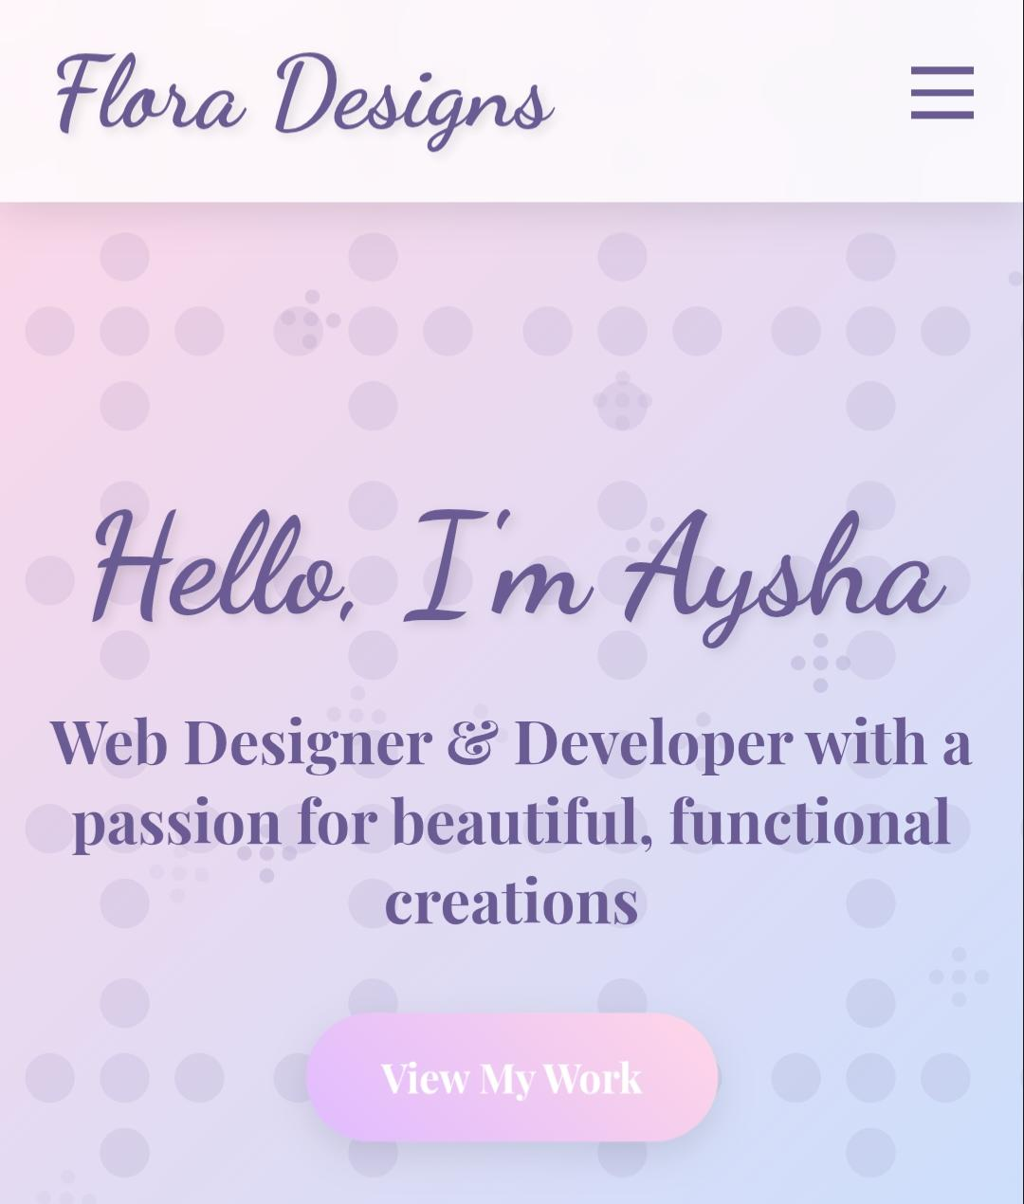
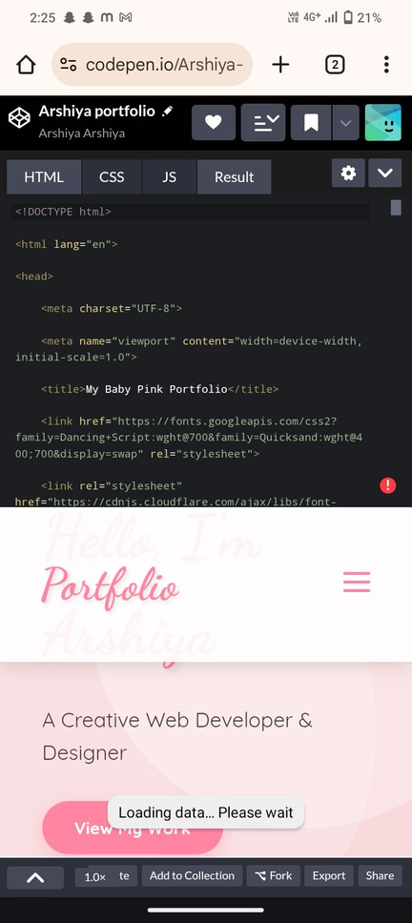
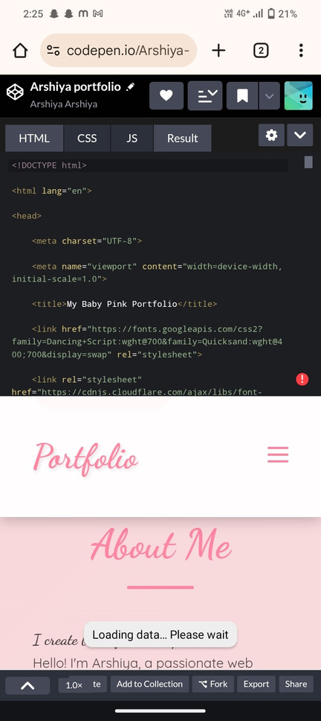
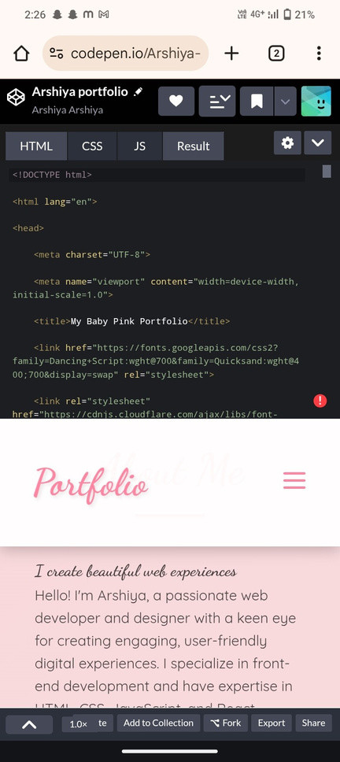
RESULT AND SCREENSHOT
RESULT AND SCREENSHOT
• •
Screenshots of each section Before vs after (plain HTML: with CSS&JS).
Screenshots of each section Before vs after (plain HTML: with CSS&JS).

Slide 10
CONCLUSION
CONCLUSION
• • •
Highlights of my project Final summary
Highlights of my project Final summary
Benefits of society
Benefits of society

Slide 11
THANK YOU
Thank You
THANKYOU

